Slide 1

Prediction of Intrusion Attacks Using Machine Learning Approach
Project Guide:
Dr. E. L. N. Kiran Kumar
By:
Batch - 88
M.SAIGANESH-2003A53011
M.KOUSHIK-2003A53010
P.SHASHI PREETHAM-2003A53001
T.ARAVIND-2003A53014

Slide 2
CONTENTS:
Abstract
Problem Statement
Literature Review
Defining Objective of the Project
Proposed Plan
Input Data &Tools Used
Implementation
Results
References

Slide 3
Abstract
Cyber-attacks are an important issue faced by all organizations. Securing information systems is critical. Organizations should be able to understand the ecosystem and predict attacks. The cyber-physical attacks worldwide have necessitated intense research efforts towards the design of attack detection and prediction mechanisms. such attacks has been proposed using Deep learning techniques which have shown promising results for predicting intrusions in computer networks. Our approach is to address prediction of attack, severity of attack would help systems to take preventive measures on time.Our results would help determine the attack analysis and provide the necessary recommendations to identify the causality and provide the inputs for predictive analytics.
Keywords: Intrusion detection, DDOS Attack , KDD 1999 Data set, Logistic Regression.

Slide 4
Problem Statement
Prediction of cyber-physical attacks, threat detection and minimizing the risk of unauthorized access and data compromise.
CLASSIFICATION - PHASE-1:
Decision Tree , Random Forest , Gradient Boost, Support Vector Machine,
PREDICTION - PHASE-2:
Logistic Regression
Django Frame Work – PHASE-3:
Implementation of Django Frame work for integration of Pickle Files and User Interface.

Slide 5
Literature Review
An Artificial Neural Network Technique for Prediction of Cyber Attack using Intrusion Detection System
Authors: Jay Kumar Jain, Akhilesh A Waoo
A neural network approach to Intrusion Detection System threat prediction.
Data set:- NSL-KDD Dataset.
Algorithm:- ANN(artificial neural network classifier)
Overall accuracy is 99.9% by proposed ANN algorithm with 0.01% of classification error .

Slide 6
Literature Review(Contd.)
Prediction Intrusion in a Network Traffic using Variance of Neighboring Object’s Distance
Authors: Krishna Gopal Sharma, Yashpal Singh
Prediction Intrusion in a Network Traffic using Variance of Neighboring Object’s Distance uses these Algorithms used are:- KNN,NNDV Binary Class Predictor
Accuracy are:-
KNNcup-99 – 0.96%
NNDV – 0.99%

Slide 7
Deep Learning Approach for SDN—Enabled Intrusion Detection System in IoT Networks
Authors: Rajasekhar Chaganti, Wael Suliman, Vinaya Kumar Ravi, Amit Dua
Deep learning owing to prevalence of IoT, LSTM, SVM, DOS & DDoS attack, Network attack on ML/DL algorithm techniques uses RNN(Recursive Neural Network)
Data set – NSL-KDD data set , KDDCup’99, non-IoT & UNSW-NB15 to train the dataset
Accuracy –NSL-KDD : 81.9%, KDDCup’99 : 96.03%, NSL-KDD : 95.98%, SDN-IoT : 97.1%
Overall Accuracy is : 97.1%

Slide 8
Cyber Security Event Detection using Machine Learning Techniques
Authors: Salman Muneer, Muhammad Bux Alvi, Amina Farrakh
Classifiers used are naïve Bayes, Bayesian, SVM,KNN based on brain networks & self –association guidelines and references inside .
AI strategies : SVM, DT, RF, LR,ANN, KNN
Intrusion attacks: AIDS(Anomaly-based IDS) & SIDS(Signature-based IDS) & uses supervised , unsupervised techniques.
Overall Accuracy based on the supervised machine learning outcomes.

Slide 9
Hierarchical Intrusion Detection using Machine Learning and Knowledge Model
Authors: Martin Sarnovsky, Jan Paralic
Goal -- symmetrical combination of the knowledge-based approach ML - techniques to build a Hierarchical IDS able to support detection of existing types and severity of network attacks.
Algorithms used - Random Forest and PA Forest.
Datasets with accuracy -- The model was tested on KDD 99, CICIDS 2017 & NSL-KDD datasets of 99,9% on KDD, 96,8% on CICIDS 2017 and 99,1% on NSL-KDD.

Slide 10
Defining Objective of the Project
Develop a robust machine learning model capable of accurately identifying intrusion attacks within a computer network.
Give Proper Recommendations to the end-users who will be using the application.
Define evaluation metrics such as accuracy, precision, recall, F1 score, and loss.
Predict the Intrusion attack and the class of attack.

Slide 11
Proposed Plan
After the detail Investigation on CICIDS 2017 Dataset, we have came to conclusion that we need to predict the Intrusion attacks in Network rather than web security attacks, so we have selected the KDD CUP data set is the best dataset for Prediction of Intrusion Attacks.
The Dataset was so huge ,so we have thought to select the a sample of Dataset for developing the Machine Learning Model.
In the Dataset there were no Recommendations for the attack and Class of Attack Type in the dataset.

Slide 12
After detail research we have Modified the dataset By Adding 2 extra Columns in the Dataset
PHASE -1:Collecting sample of KDDCUP 99 Dataset, Pre-processing the data
PHASE -2:Including the 2 columns in the KDDCUP Dataset, Splitting the Dataset for training and testing
PHASE -3:Implementing the intrusion attack prediction model, Displaying the Appropriate results and recommendations based on corresponding Inputs

Slide 13
Input Data &Tools Used
Data Set:
we have taken the dataset from KDD’1999 year and Made few changes added few coloumns in the dataset.
Used Modified Dataset for Developing Machine Learning Model.
Tech-Stack:
HTML , CSS ,JS ,Python(3.7) and Framework(Django)

Slide 14
Implementation
We should enter the login details.
We should enter input details.
If we submit we can see Details of Attack like attack and class of attack ,recommendations and precautions.
If we click on Graphical Analysis we can see the confusion Matrix and Model test Metrics.
If we click on Logout,we get back to index screen(login page).

Slide 15

Results

Slide 16
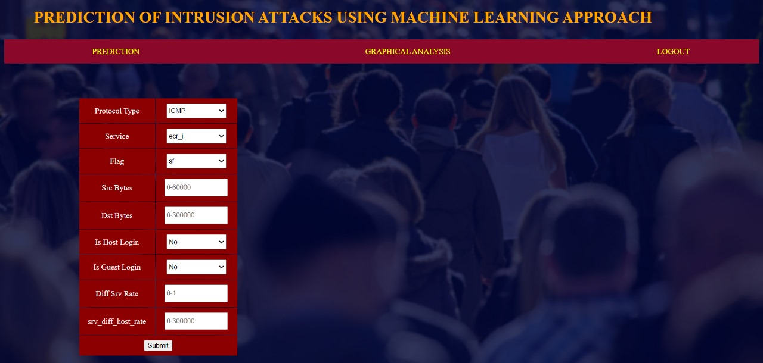

Slide 17


Slide 18
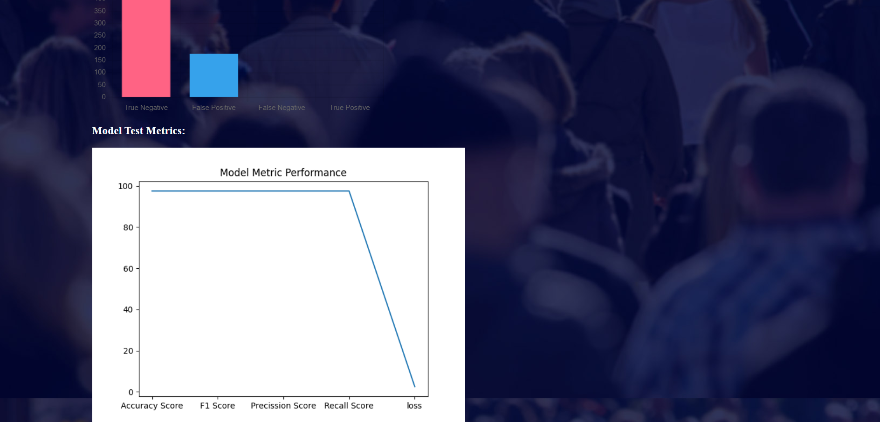

Slide 19
References
Jain, J. K., & Waoo, A. A. (2023). An Artificial Neural Network Technique for Prediction of Cyber-Attack using Intrusion Detection System. Journal of Artificial Intelligence, Machine Learning and Neural Network (JAIMLNN) ISSN: 2799-1172, 3(02), 33-42.
Sharma, K. G., & Singh, Y. (2023). Predicting Intrusion in a Network Traffic Using Variance of Neighbouring Object’s Distance. International Journal of Computer Network and Information Security, 13(2), 73.
Chaganti, R., Suliman, W., Ravi, V., & Dua, A. (2023). Deep learning approach for SDN-enabled intrusion detection system in IoT networks. Information, 14(1), 41.
Muneer, S. M., Alvi, M. B., & Farrakh, A. (2023). Cyber Security Event Detection Using Machine Learning Technique. International Journal of Computational and Innovative Sciences, 2(2), 42-46.
Sarnovsky, M., & Paralic, J. (2020). Hierarchical intrusion detection using machine learning and knowledge model. Symmetry, 12(2), 203.

Slide 20
Thank You

